Slide 1

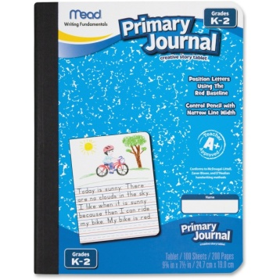
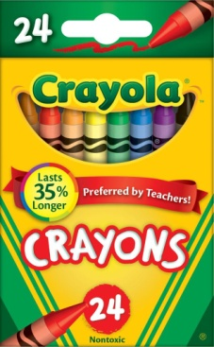
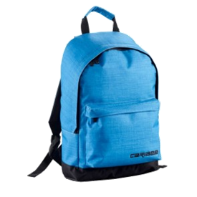
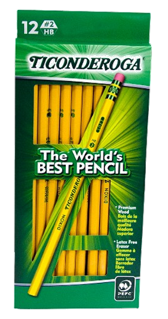
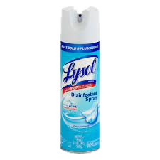
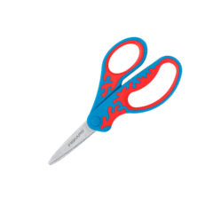
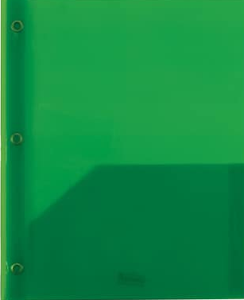
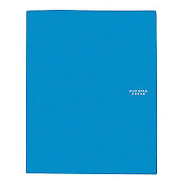
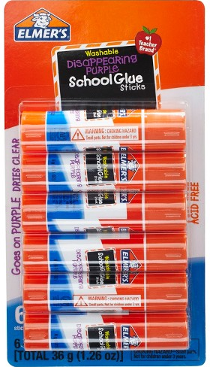
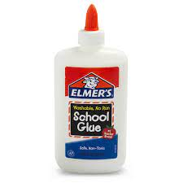
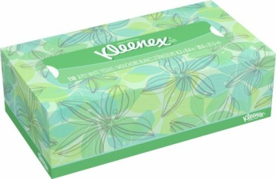
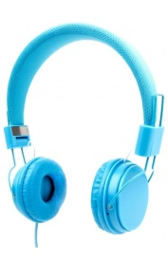
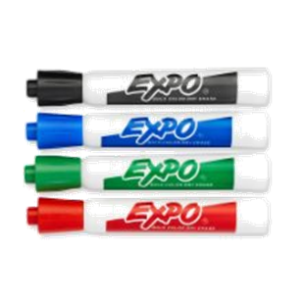
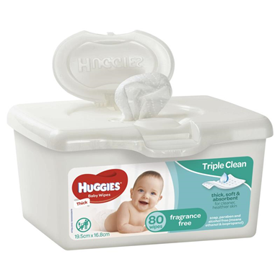
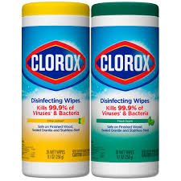
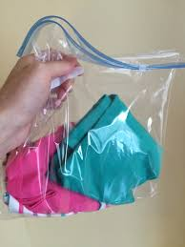
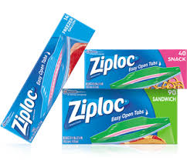
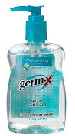
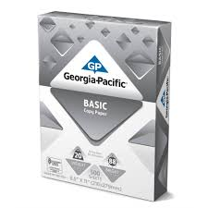
Classroom Supply List
Please provide the following supplies to be used at school.
3 Primary Composition
Notebooks
5 packs of 24
Crayola Crayons
1 backpack to bring school
everyday
2 packs of 24 pencil
ticonderoga
2 Lysol Spray
1 pair of scissors
2 plastic folder
w/pockets and prongs
green and blue
2 bottles of glue
4 pack of glue sticks
4 box of tissues
1 pair of headphones
(NO ear buds)
2 containers of baby wipes
2 containers of Clorox wipes
3 packs of dry
erase markers
ziploc bags
girls-quart
boys-gallon
change of clothing
Shirt, pants, socks, underwear
3 containers of hand
sanitizer
2 reams of copy paper

